Slide 1
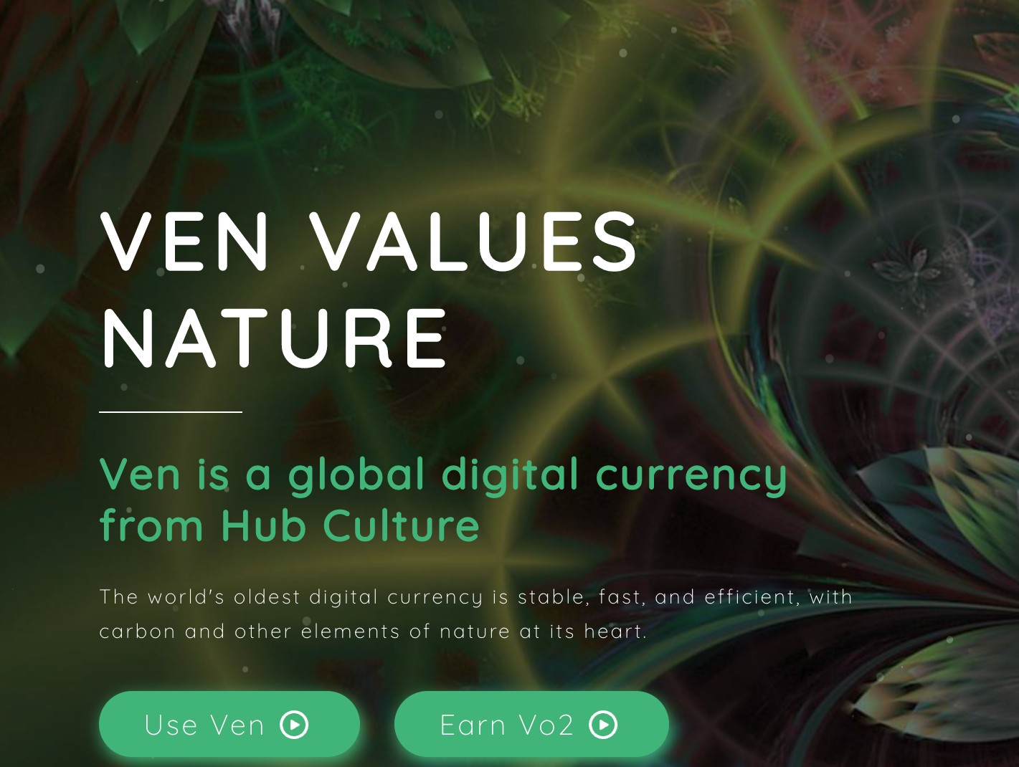
CARBON
@hubculture HubCulture.com

Slide 2
Ven Carbon
The newest addition to the Ven financial asset family, announced at COP27: Ven Carbon (Vco2) joins Ven and Ven Oxygen (Vo2).
Verifiable Carbon set to CBL/Xpansiv GEO certification, the emerging ‘Brent crude’ of carbon
Provides a single global liquid reference price for Carbon
Runs on Hedera with interchange to 4 major blockchain systems
In 2023, Hub Culture Origination will use Hubs to allow project originators to onboard projects for seamless tokenization and purchase into the Vco2 portfolio.
Upweights important biodiversity regions, forests, wilderness
HubID identity management for Entities, Locations and Commons based payments and exchange enable KYC and Community
Includes digital mapping and authentication, Registry Verification

Slide 3
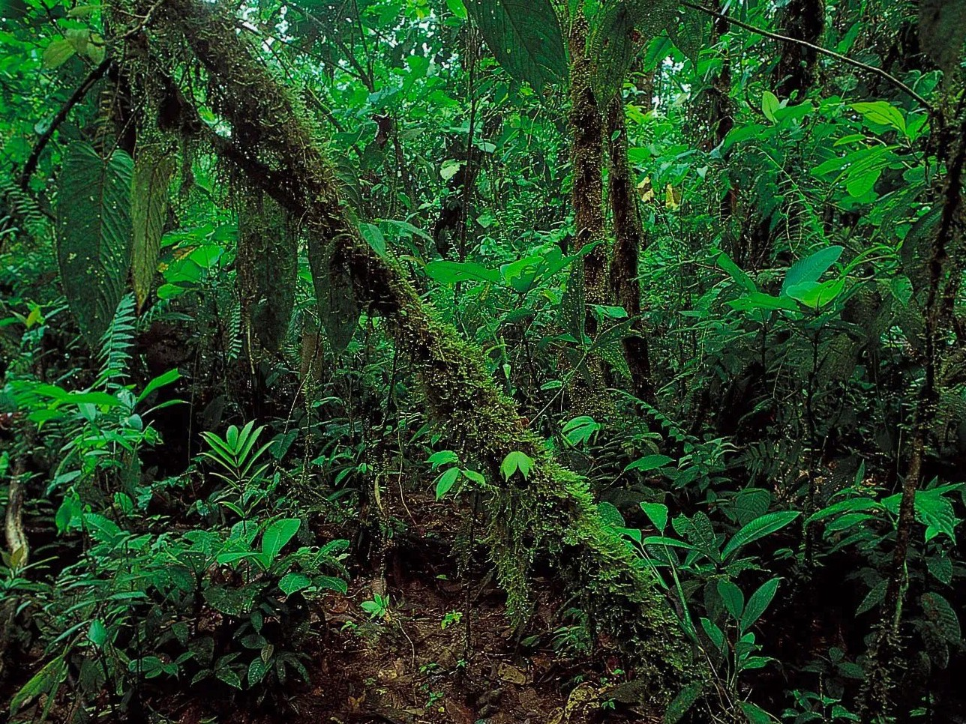
Protect Biodiversity Empower the Commons
Transparency and Traceability Increased Liquidity

Slide 4
Blue Carbon
Biodiversity
@hubculture HubCulture.com

Slide 5
@hubculture HubCulture.com

Slide 6
Contacts
HubCulture.com Ven.vc
Carbon@HubCulture.com
@hubculture HubCulture.com

